Slide 1
STRONGLY CONNECTED COMPONENTS
PRESENTERS:
TURZA PODDER – 011 191 239
MOHIUDDIN MUNNA – 011 173 035

Slide 2
TOPICS WILL BE COVERED ARE
01
INTRODUCTION
WHAT IS STRONGLY CONNECTED COMPONENT AND KOSAJARU ALGORITHM ?
02
TIME & SPACE COMPLEXITY
HOW MUCH TIME AND SPACE NEEDED TO RUN THIS ALGORITHM
03
ALGORITHM IMPLEMENTATION
A VERBAL DESCRIPTION OF HOW TO FIND SCC USING DSA
04
CODE
DETAIL CODE AND HOW IT WORKS

Slide 3
INTRODUCTION
What is strongly Connected Component?
A strongly connected component is the portion of a directed graph in which there is a path from each vertex to another vertex. It is applicable only on a directed graph.

Slide 4
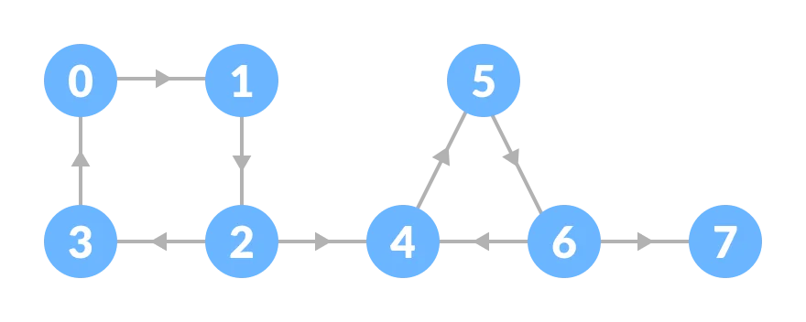
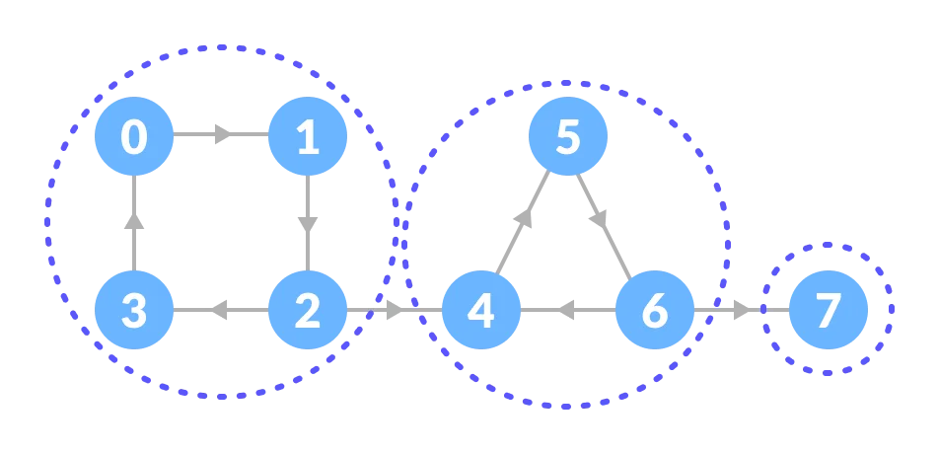
A
VISUAL
REPRESENTATION
Here This Red Marked Components Are Strongly Connected. Because, In These Components
There Is A Path To Visit Every Other Vertex

Slide 5
Available Algorithms
To solve this problem we can use two algorithms:
Kosaraju’s Algorithm
Tarjan’s Algorithm
.
Kosaraju Algorithm
Kosaraju's algorithm needs to perform DFS 2 times, and between first and second DFS, it needs to find the transpose of the graph.
So that constant factor can be double time.
Point is, that we can print SCC on the fly
with Kosaraju's algorithm as it performs
second DFS, so you don't need extra time
for that.
Tarjan’s Algorithm
Tarjan's algorithm on the other hand, perform only 1 DFS using idea similar to algorithm for articulation point
detection(low and Disc values).
When performing Tarjan's algorithm,
It needs extra time to print SCC when It finds a head of SCC subtree.

Slide 6
Kosaraju's Algorithm
To find strongly connected components from a directed graph we will use kosaraju’s algorithm.
Kosaraju's algorithm is a linear time algorithm to find the strongly connected components of a directed graph
Kosaraju's Algorithm is based on the depth-first search algorithm implemented twice.
Steps:
Call DFS(G) to compute finish time for each vertex
Reverse the Graph
Call DFS(G^{T}) on vertices in decreasing order of their finish time
Output: vertices separated as SCC’s

Slide 7
Time Complexity
Let’s Discuss about the Time Complexity of Kosaraju’s Algorithm
The time complexity of Kosaraju’s Algorithm will be O(V + E), where V represents the set of vertices and E represents the set of edges of the graph. In Kosaraju’s algorithm, the traversal of the graph is done at least 2 times, so the constant factor can be of double time. We can print the SCC in progress with Kosaraju’s algorithm as we perform the second DFS.
N:B:-If the graph is represented as an adjacency matrix, the algorithm requires Ο(V²) time.

Slide 8
IMPLEMENTATION
IN THIS SECTION WE WILL COVER A GRPAHICS SIMULATION OF HOW TO FIND STRONGLY CONNECTED COMPONENTS
Step: 1
0
1
555
Perform a depth first search on the whole graph.
Let us start from vertex-0, visit all of its child vertices, and mark the visited vertices as done. If a vertex leads to an already visited vertex, then push this vertex to the stack.
3
2
4
6
7
Visited
Stack

Slide 9
IMPLEMENTATION
IN THIS SECTION WE WILL COVER A GRPAHICS SIMULATION OF HOW TO FIND STRONGLY CONNECTED COMPONENTS
Step: 1
0
1
555
Perform a depth first search on the whole graph.
Let us start from vertex-0, visit all of its child vertices, and mark the visited vertices as done. If a vertex leads to an already visited vertex, then push this vertex to the stack.
3
2
4
6
7
Visited | 0 | 1
Stack

Slide 10
IMPLEMENTATION
IN THIS SECTION WE WILL COVER A GRPAHICS SIMULATION OF HOW TO FIND STRONGLY CONNECTED COMPONENTS
Step: 1
0
1
555
Perform a depth first search on the whole graph.
Let us start from vertex-0, visit all of its child vertices, and mark the visited vertices as done. If a vertex leads to an already visited vertex, then push this vertex to the stack.
3
2
4
6
7
Visited | 0 | 1 | 2 | 3
Stack

Slide 11
IMPLEMENTATION
IN THIS SECTION WE WILL COVER A GRPAHICS SIMULATION OF HOW TO FIND STRONGLY CONNECTED COMPONENTS
Step: 1
0
1
555
Perform a depth first search on the whole graph.
Let us start from vertex-0, visit all of its child vertices, and mark the visited vertices as done. If a vertex leads to an already visited vertex, then push this vertex to the stack.
Here, Vertex-3 leads to already visited vertex-0, so push the source vertex (ie. vertex-3) into the stack.
3
2
4
6
7
Visited | 0 | 1 | 2 | 3
Stack | 3

Slide 12
IMPLEMENTATION
IN THIS SECTION WE WILL COVER A GRPAHICS SIMULATION OF HOW TO FIND STRONGLY CONNECTED COMPONENTS
Step: 1
0
1
555
Perform a depth first search on the whole graph.
Let us start from vertex-0, visit all of its child vertices, and mark the visited vertices as done. If a vertex leads to an already visited vertex, then push this vertex to the stack.
Now Backtrack and go to previous vertex and visit its child vertices
3
2
4
6
7
Visited | 0 | 1 | 2 | 3 | 4
Stack | 3

Slide 13
IMPLEMENTATION
IN THIS SECTION WE WILL COVER A GRPAHICS SIMULATION OF HOW TO FIND STRONGLY CONNECTED COMPONENTS
Step: 1
0
1
555
Perform a depth first search on the whole graph.
Let us start from vertex-0, visit all of its child vertices, and mark the visited vertices as done. If a vertex leads to an already visited vertex, then push this vertex to the stack.
3
2
4
6
7
Visited | 0 | 1 | 2 | 3 | 4 | 5
Stack | 3

Slide 14
IMPLEMENTATION
IN THIS SECTION WE WILL COVER A GRPAHICS SIMULATION OF HOW TO FIND STRONGLY CONNECTED COMPONENTS
Step: 1
0
1
555
Perform a depth first search on the whole graph.
Let us start from vertex-0, visit all of its child vertices, and mark the visited vertices as done. If a vertex leads to an already visited vertex, then push this vertex to the stack.
3
2
4
6
7
Visited | 0 | 1 | 2 | 3 | 4 | 5 | 6
Stack | 3

Slide 15
IMPLEMENTATION
IN THIS SECTION WE WILL COVER A GRPAHICS SIMULATION OF HOW TO FIND STRONGLY CONNECTED COMPONENTS
Step: 1
0
1
555
Perform a depth first search on the whole graph.
Let us start from vertex-0, visit all of its child vertices, and mark the visited vertices as done. If a vertex leads to an already visited vertex, then push this vertex to the stack.
Since there is nowhere to go from vertex-7, push it into the stack
3
2
4
6
7
Visited | 0 | 1 | 2 | 3 | 4 | 5 | 6 | 7
Stack | 3 | 7

Slide 16
IMPLEMENTATION
IN THIS SECTION WE WILL COVER A GRPAHICS SIMULATION OF HOW TO FIND STRONGLY CONNECTED COMPONENTS
Step: 1
0
1
555
Perform a depth first search on the whole graph.
Let us start from vertex-0, visit all of its child vertices, and mark the visited vertices as done. If a vertex leads to an already visited vertex, then push this vertex to the stack.
Go to the previous vertex (vertex-6) and visit its child vertices. But, all of its child vertices are visited, so push it into the stack.
3
2
4
6
7
Visited | 0 | 1 | 2 | 3 | 4 | 5 | 6 | 7
Stack | 3 | 7 | 6

Slide 17
IMPLEMENTATION
IN THIS SECTION WE WILL COVER A GRPAHICS SIMULATION OF HOW TO FIND STRONGLY CONNECTED COMPONENTS
Step: 1
0
1
555
Perform a depth first search on the whole graph.
Let us start from vertex-0, visit all of its child vertices, and mark the visited vertices as done. If a vertex leads to an already visited vertex, then push this vertex to the stack.
Finally A Stack is created.
3
2
4
6
7
Visited | 0 | 1 | 2 | 3 | 4 | 5 | 6 | 7
Stack | 3 | 7 | 6 | 5 | 4 | 2 | 1 | 0

Slide 18
IMPLEMENTATION
IN THIS SECTION WE WILL COVER A GRPAHICS SIMULATION OF HOW TO FIND STRONGLY CONNECTED COMPONENTS
Step: 2
0
1
555
Now Reverse or Transpose the whole Graph (GT)
3
2
4
6
7
Visited
Stack | 3 | 7 | 6 | 5 | 4 | 2 | 1 | 0

Slide 19
IMPLEMENTATION
IN THIS SECTION WE WILL COVER A GRPAHICS SIMULATION OF HOW TO FIND STRONGLY CONNECTED COMPONENTS
Step: 2
0
1
555
Now Reverse or Transpose the whole Graph (G^{T})
3
2
4
6
7
Visited | 0
Stack | 3 | 7 | 6 | 5 | 4 | 2 | 1
SCC

Slide 20
IMPLEMENTATION
IN THIS SECTION WE WILL COVER A GRPAHICS SIMULATION OF HOW TO FIND STRONGLY CONNECTED COMPONENTS
Step: 3
0
1
555
Start from the top vertex of the stack. Traverse through all of its child vertices. Once the already visited vertex is reached, one strongly connected component is formed.
Pop vertex-0 from the stack. Starting from vertex-0, traverse through its child vertices (vertex-0, vertex-1, vertex-2, vertex-3 in sequence) and mark them as visited. The child of vertex-3 is already visited, so these visited vertices form one strongly connected component.
3
2
4
6
7
Visited | 0 | 1 | 2 | 3
Stack | 3 | 7 | 6 | 5 | 4 | 2 | 1
SCC | 0 | 1 | 2 | 3

Slide 21
IMPLEMENTATION
IN THIS SECTION WE WILL COVER A GRPAHICS SIMULATION OF HOW TO FIND STRONGLY CONNECTED COMPONENTS
Step: 3
0
1
555
Start from the top vertex of the stack. Traverse through all of its child vertices. Once the already visited vertex is reached, one strongly connected component is formed.
Go to the stack and pop the top vertex if already visited. Otherwise, choose the top vertex from the stack and traverse through its child vertices as presented above.
3
2
4
6
7
Visited | 0 | 1 | 2 | 3 | 4 | 5 | 6
Stack | 3 | 7 | 6 | 5
SCC | 4 | 5 | 6

Slide 22
IMPLEMENTATION
IN THIS SECTION WE WILL COVER A GRPAHICS SIMULATION OF HOW TO FIND STRONGLY CONNECTED COMPONENTS
Step: 3
0
1
555
Start from the top vertex of the stack. Traverse through all of its child vertices. Once the already visited vertex is reached, one strongly connected component is formed.
Vertex-7 has no adjacent vertex so, it’s own is a strongly connected component.
3
2
4
6
7
Visited | 0 | 1 | 2 | 3 | 4 | 5 | 6 | 7
Stack
SCC | 7

Slide 23
IMPLEMENTATION
IN THIS SECTION WE WILL COVER A GRPAHICS SIMULATION OF HOW TO FIND STRONGLY CONNECTED COMPONENTS
Step: 4
So, This is the output.
We can see there is three strongly connected components.
0
1
555
3
2
4
6
7

Slide 24
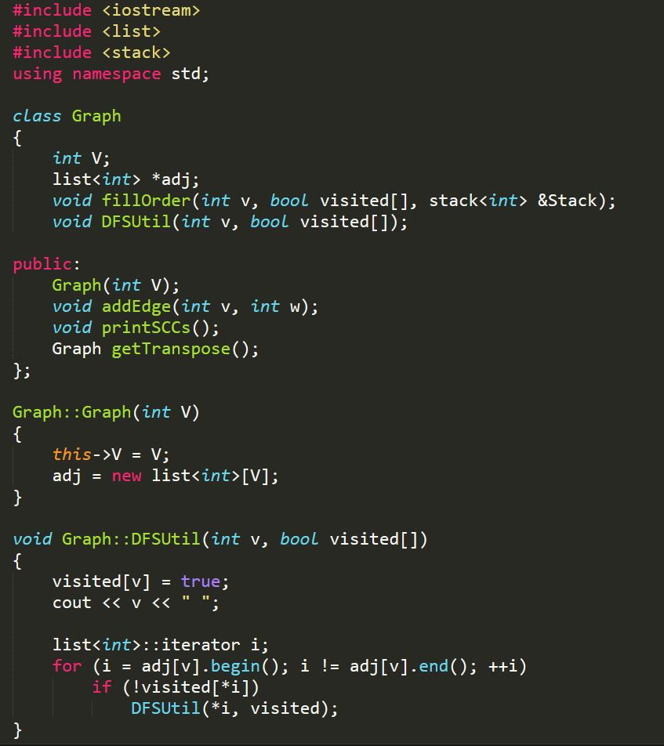
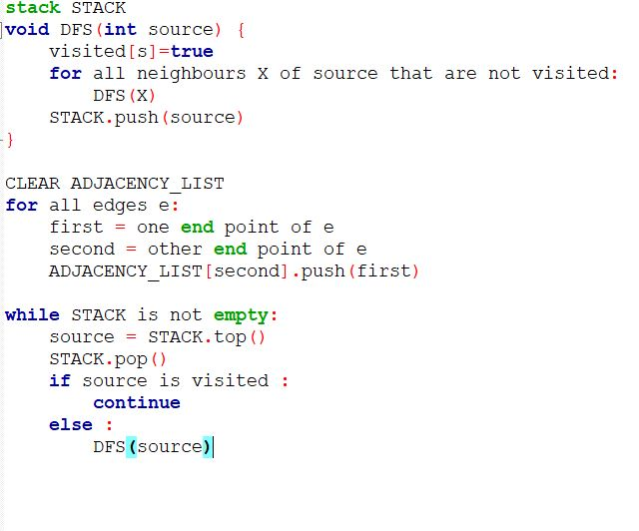
Code
Now We learn about the main code to know how it actually works in Computers
Pseodu-Algorithm

Slide 25
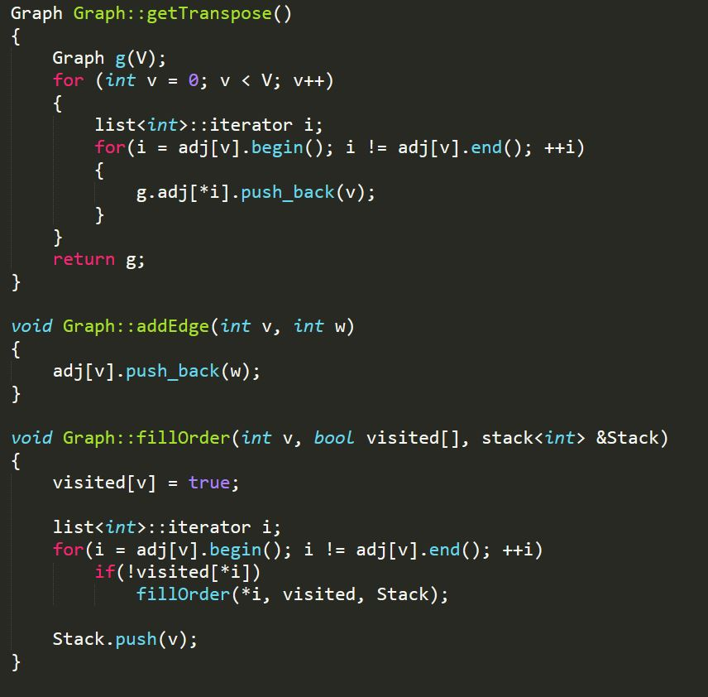
Code
Now We learn about the main code to know how it actually works in Computers
Pseodu-Algorithm

Slide 26
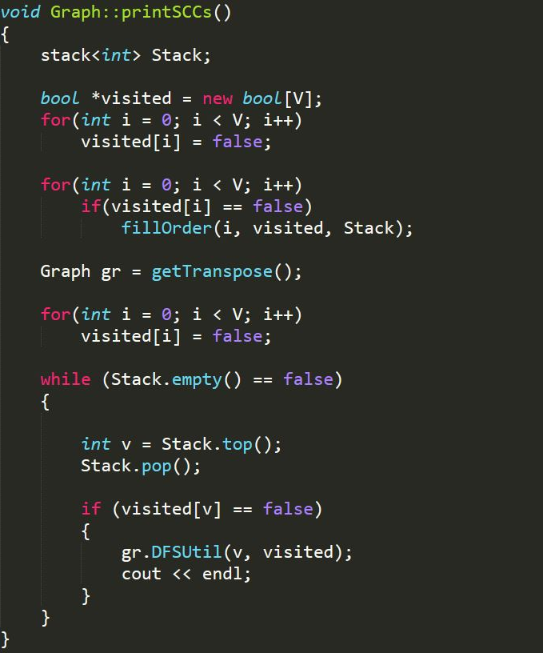
Code
Now We learn about the main code to know how it actually works in Computers
Pseudocode

Slide 27
Thank you
We Hope, we’ve helped you to understand our
Todays agenda

